Slide 1
COVID-19 and Remote Working
Ahmet Enes Topcu, 150210310
Alihan Esen, 150220338
Bedirhan Ozturk, 150210321
ITU
Faculty of Computer and Informatics

Slide 2
Thesis
The COVID-19 pandemic has significantly transformed the remote work industry, with profound impacts on employees, employers, and technology, influencing the way work is conducted and reshaping the future of work arrangements.

Slide 3
The Impact of COVID-19 on
Employees
Employers
Technology

Slide 4
Impact on Employees
Employee Well-being and Productivity

Slide 5
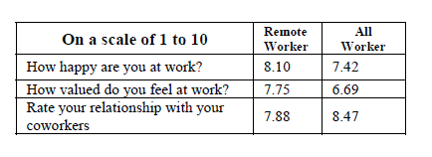
Impact on Employees
Employee Well-being and Productivity
Mental Health
How do they feel about remote-working?
What do people say?
Comparison of the results.
Table 1.1

Slide 6
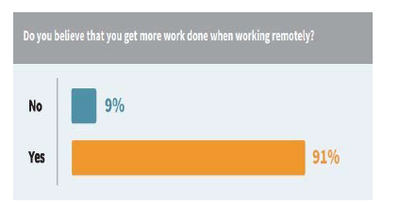
Impact on Employees
Employee Well-being and Productivity
Productivity
What is the answers about production ?
What affects productivity ?
Comparison of the results.
Figure 1.1

Slide 7
Impact on Employers
Adaptation to remote work

Slide 8

Impact on Employers
Adaptation to Remote Work
Implementation of Remote Work
Various mechanisms
(Alaameri et al., 2021)
Beginning to change
Figure 2.1

Slide 9

Impact on Employers
Adaptation to Remote Work
Changes in Company’s Strategies
Professional people
(Alaameri et al., 2021)
Help from country
Figure 2.2

Slide 10
Impact on Employers
Cost Savings and Productivity

Slide 11

Impact on Employers
Cost Savings and Productivity
Reduction in Office-Related Expenses
Travel expenses
Daily operating costs
Figure 2.3

Slide 12

Impact on Employers
Cost Savings and Productivity
Investments in Technology and Remote Work Infrastructure
Unique opportunity to see
(Donthu et al., 2020)
Different approaches to handle
(Donthu et al., 2020)
Figure 2.4
Notes:
Thank you for listening, and I look forward to answer any questions or further discussion on this critical topic.

Slide 13
Impact on Technology
Technological Advancements for Remote Work

Slide 14
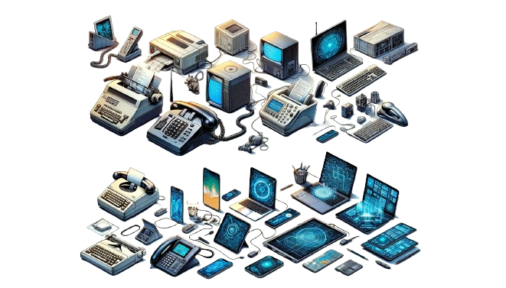
Impact on Technology
Technological Advancements for Remote Work
Evolution of Remote Work Tools and Platforms
Free of charge
Screen sharing
Meeting participants
Whiteboard
Recording meetings
Mobile app
Shi (2020)
Figure 3.1

Slide 15

Impact on Technology
Technological Advancements for Remote Work
Cybersecurity and Data Protection
Figure 3.2

Slide 16
Impact on Technology
Future of Remote Work Technology

Slide 17
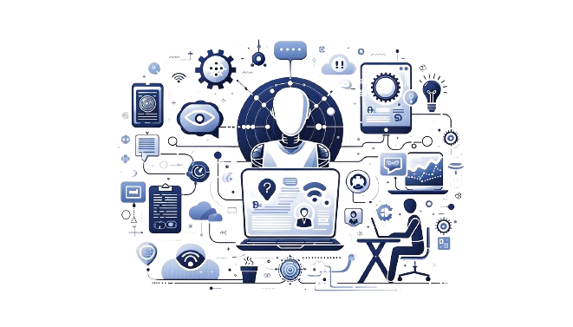
Impact on Technology
Future of Remote Work Technology
The Role of Artificial Intelligence and Automation
1%
14%
Artificial
Intelligence
Productivity
Gao & Feng (2023)
Figure 3.3

Slide 18
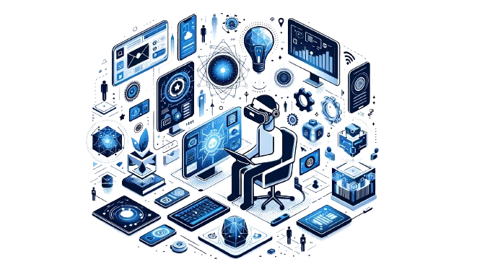
Impact on Technology
Future of Remote Work Technology
Augmented and Virtual Reality in Remote Work
Figure 3.4

Slide 19
References
Alameeri, K.A., Alshurideh, M.T., Al Kurdi, B. (2021). The effect of COVID-19 Pandemic on business systems’ innovation and entrepreneurship and how to cope with it: A theatrical view. In M., Alshurideh, A. E., Hassanien, R., Masa’deh (Eds.) Studies in Systems, Decision and Control: Vol. 334. The effect of coronavirus disease (COVID-19) on business intelligence (pp. 275-288). Springer. https://doi.org/10.1007/978-3-030-67151-8_16
Donthu N., Gustafsson, A. (2020) Effects of COVID-19 on business and research, Journal of Business Research, 117, 284-289. https://doi.org/10.1016/j.jbusres.2020.06.008
Elshaiekh, N. E. M., Hassan, Y. A. A., & Abdallah, A. A. A. (2018). The impacts of remote working on workers' performance. 2018 International Arab Conference on Information Technology (ACIT), Lebanon, (pp. 1-5). IEEE. https://doi.org/10.1109/ACIT.2018.8672704
Galanti, T., Guidetti, G., Mazzei, E., Zappalà, S., & Toscano, F. (2021). The impact of remote work on employees' productivity, engagement, and stress during the COVID-19 outbreak. Journal of Occupational and Environmental Medicine, 63(7), 426–432. https://doi.org/10.1097/JOM.0000000000002236

Slide 20
References
Gao, X., & Feng, H. (2023). AI-driven productivity gains: Artificial intelligence and firm productivity. Sustainability, 15(11), 8934. http://dx.doi.org/10.3390/su15118934
Kurdy, D.M., Al-Malkawi, H.-A.N. & Rizwan, S. (2023). The impact of remote working on employee productivity during COVID-19 in the UAE: the moderating role of job level. Journal of Business and Socio-Economic Development, 3(4), 339-352. https://doi.org/10.1108/JBSED-09-2022-0104
Pidel, C., & Ackermann, P. (2020). Collaboration in virtual and augmented reality: A systematic overview. In L. De Paolis & P. Bourdot (Eds.), Lecture notes in computer science: Vol. 12242. Augmented reality, virtual reality, and computer graphics (pp. 141-156). Springer. https://doi.org/10.1007/978-3-030-58465-8_10
Shi, Y. (2021) Research of the development of distance learning under the COVID-19 circumstances based on video conferencing software and MOOCs. 2021 2nd International Conference on Education, Knowledge and Information Management, China, (pp. 154-158). IEEE. https://doi.org/10.1109/ICEKIM52309.2021.00042

Slide 21
References
Figure 2.1
Figure 2.2
Figure 2.3
Figure 2.4
These images were generated by OpenAI’s ChatGPT4 and Dall-E.
Figure 3.1
Figure 3.2
Figure 3.3
Figure 3.4
Elshaiekh, N. E. M., Hassan, Y. A. A., & Abdallah, A. A. A. (2018). The impacts of remote working on workers' performance. 2018 International Arab Conference on Information Technology (ACIT), Lebanon, (pp. 1-5). IEEE. https://doi.org/10.1109/ACIT.2018.8672704
Figure 1.1
Table 1.1

